Slide 1
THE ROLE OF THE AGENCY LIAISON IN THE SECC
Claude Denver
SECC Manager, DHS&EM
October 1, 2010

Slide 2
Purpose of this Presentation
To provide agency liaisons on their responsibilities when assigned to the SECC.
This presentation covers:
What is the SECC?
The role of the SECC in emergency management
SECC activation and disaster assistance
The agency liaison role in the SECC
Basic duties of the liaison
Liaison preparation tools
Practice Scenarios

Slide 3
State Emergency Coordination Center
The DHS&EM manages disaster emergencies per Alaska Statute 26.23.
DHS&EM is involved in all emergency management efforts including preparedness, response, recovery, and mitigation.
When an emergency event occurs, normal work must transition quickly to respond to the needs of the residents, communities, and state.
In 1994, the SECC was created to enable this transition.
Notes:
The DHS&EM manages disaster emergencies per Alaska Statute 26.23.
Disaster emergency management includes 4 phases:
Mitigation
Preparedness
Response
Recovery.
When a emergency event occurs, normal work must transition to respond to the needs of the residents, communities, and state.
1994, DHS&EM created the State Emergency Coordination Center (SECC) to enable this transition

Slide 4
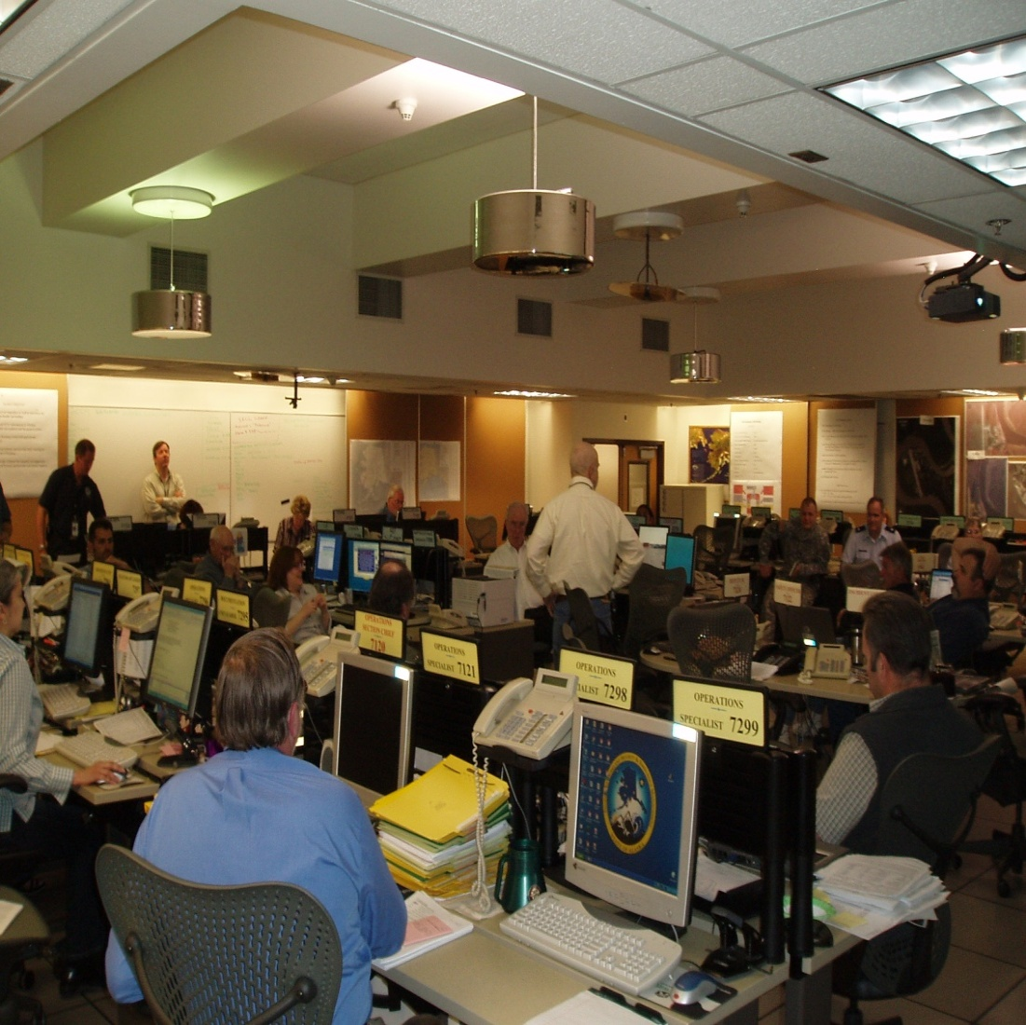
What is the SECC?
The SECC, like an EOC, is many things:
a location from which centralized emergency management can be performed.
a structure housing emergency management staff handling the incident.
the function dealing with policy making, management, and coordination.

Slide 5
SECC Mission
The SECC exists to:
gather, process, and report emergency situation intelligence.
aid in State policy and decision making.
support local communities as they direct and control disaster or emergency response operations.
account for the State’s response costs.
Notes:
Gather, process and report emergency situation intelligence to aid in State policy and decision making
Support local communities as they direct & control disaster emergency response operations
Account for the State’s response support costs

Slide 6
SECC - Goals
Save lives
Ensure the safety and health of all responders
Reduce suffering and care for casualties
Protect public health
Protect government infrastructure
Protect personal, private, and commercial property
Protect the environment
Reduce economic and social losses
Restore the area to normal as soon as possible

Slide 7
What the SECC Provides
24-hour operation able to expand during emergencies and disasters
0730 – 1700 hrs coverage by Operations Staff
After hours coverage via a toll-free telephone number (MATCOMM) forwarded to a SECC Duty Officer.
Daily communication checks with local, state, and federal agencies
Continuous assessment/evaluation of the Alaska situation followed up with warnings to potential affected communities of threats.
Preparation of Daily Situation Report
Utilization of standard Action/Preparedness Levels

Slide 8
SECC Functional Layout
Five primary sections
Command (8 stations)
Operations (6 stations)
Planning (6 stations)
Logistics (8 stations)
Finance/Administration (4 stations)
Two support sections
Liaisons (12 stations) – assigned seats as shown
Graphics Support (2 stations)
USCG
DPS
LIAISON
DOD
AKNG
CAP
DEC
DOT
ARC
VOAD
DHSS
FEMA

Slide 9
SECC Assistance During the Pre-Disaster Phase
Coordination with private non-profit, volunteer, state, military, and federal response, relief, and recovery agencies.
Provide technical assistance.
Assist with evacuation planning.
Warn potentially-affected communities of imminent or potential dangers.
Activate emergency alert system via governmental communication systems.
Prime statewide resources for possible logistics requests.
Notes:
Coordination with private non-profit, volunteer, state, military, and federal response, relief, and recovery agencies.
Provide technical assistance with preparedness, planning, mitigation, and response actions.
Assist with evacuation planning.
Warn potentially-affected communities of imminent or potential dangers.
Activate emergency alert system via a multitude of local, state, and federal communication systems.
Prime statewide resources for possible logistics requests.

Slide 10
Upgrading from Normal Operations
If certain criteria are met (e.g., requests for assistance from local emergency officials, evidence of potentially-dangerous or damaging events, etc.), the SECC can be activated and rapidly staffed.
This transition from normal duties to SECC activation is characterized by four preparedness levels
Level 1: Routine operations; SECC usually not activated.
Level 2: Heightened sense of awareness; SECC may be activated.
Level 3: Actual event occurring; SECC partially/fully activated.
Level 4: Event or operations occur in response to major loss of life, life-threatening, environmental or property damaging event; SECC fully staffed.

Slide 11
SECC Activation Criteria
Significant number of people at risk.
Potential or actual threat to people, property and/or environment.
Significant response/evacuation coordination required.
Inadequate local resources or there is need for outside help.
Uncertain future conditions – situation likely or expected to get worse.
Unknown scope of damage or there are multiple locations.
Local officials are overwhelmed, slow to act, understaffed, etc.

Slide 12
SECC Activation Flowchart
EVENT OCCURS OR IS IMMINENT;
SECC ALWAYS AT LEVEL 1
HEIGHTENED AWARENESS:
SMALL EVENT/THREAT
SINGLE LOCATION
FEW AGENCIES
STATE HELP MAY BE NEEDED OR REQUESTED BY LOCALS
SECC LEVEL 2
LIMITED FUNCTIONS ACTIVATED BASED ON CONDITIONS; RESPONSE MAY BE HANDLED BY OPS SECTION ONLY
Yes
DETERMINE UPGRADE TO HIGHER SECC ACTIVATION LEVEL
EVALUATE FOR SECC ACTIVATION; IS THE ACTIVATION CRITERIA MET?
ACTUAL EVENT/EMERGENCY:
MODERATE EVENT/THREAT
2 OR MORE SITES
SEVERAL AGENCIES
LIMITED EVACUATIONS
STATE DISASTER
SECC LEVEL 3
PARTIAL FUNCTIONS ACTIVATED (IC, SECTION CHIEFS, PIO, LIAISONS, AND OTHERS AS NECESSARY
No
EVENT RESOLVED OR BEING ADEQUATELY HANDLED BY LOCAL OFFICIALS WITHOUT HELP
KEEP AT SECC LEVEL 1
MAJOR DISASTER:
MAJOR EVENT/THREAT
WIDESPREAD/MANY SITES
MANY AGENCIES
FEDERAL DISASTER
SECC LEVEL 4
ALL FUNCTIONS ACTIVATED TO UNIT LEVEL. ALL LIAISONS ACTIVATED
MONITOR SITUATION; MAINTAIN READINESS TO RESPOND IF REQUIRED/REQUESTED

Slide 13
Initial Response Flow
EVENT OCCURS
DHS&EM notified of emergency. DHS&EM contacts community to verify status and determine level of assistance needed. Is this a true emergency? Can they handle situation? What really do they need?
DHS&EM Operations monitors situation and remains ready to assist if needed. Non-emergency events will be handled in coordination with other agencies.
No
Yes
Notify appropriate DHS&EM staff, leadership, borough, state, federal, and non-profit agencies. What are their priority needs? Can other agencies/entities help?
No
DHS&EM Operations activates and staffs SECC. Initiate/support immediate response by DHS&EM and/or appropriate agencies. Deploy state liaison or DIRT to impacted area if appropriate.
IS RESCUE NEEDED?
Are lives in danger? Have there been any deaths? Is there anyone missing, sick, or injured? Is an evacuation occurring, expected, or planned?
Yes
No
Initiate/support expedited response by DHS&EM and appropriate State, Federal, Volunteer agencies. Safeguard situation to ensure against relapses into Rescue and Relief modes
IS IMMEDIATE RELIEF NEEDED?
Are there immediate needs to protect lives, public health, critical infrastructure, or public property? Are there debris clearing, individual assistance (e.g., temporary housing/shelter, food, water, etc.) or other needs?
Monitor incident until immediate concerns are met and/or incident is stabilized. Lead damage assessment teams. Compile data into Fact Sheet for DPC meeting. Follow DPC instructions. Transfer incident to Disaster Assistance Section for management.
No
IS SHORT-TERM RECOVERY NEEDED?
Debris removal, temporary critical and utility infrastructure repair, communication, etc.
Yes
No
IS LONG-TERM RECOVERY NEEDED?
State/FEMA individual assistance and public assistance (Category A through G) project work, and small business assistance.
Yes
Assist Disaster Assistance Section with project worksheet development, applicant briefings, and kickoff meetings, as requested.

Slide 14
SECC Action Phases
A helpful planning tool for dealing with emergencies is to address the community’s needs on the basis of response, relief, and recovery. Liaisons could be used during any phase.
These actions or phases are described below:
Response includes activities to address the immediate actions to preserve life, property, environment, and the social, economic, and political structure of the community.
Relief provides for short-term assistance (typically less than four weeks) to people impacted by the emergency event and includes the repair and restoration of essential lifeline systems.
Long-term recovery efforts, four weeks to several years following an event. There is considerable evidence that planning for recovery during the response phase will speed recovery time and reduce losses.

Slide 15
Response, Relief, and Recovery Actions
Response (Immediate) | Relief (Short-term) | Recovery (Long-term)
Search and rescue Emergency shelter, housing, food, water, fuel, and energy Emergency medical and mortuary services Public health and safety Decontamination after a chemical, biological or radiological incident Removal of threats to the environment Emergency restoration of critical services (electric and natural gas services, water, sewer, telephone) Transportation, logistics, and other emergency services Private sector provision of needed goods and services through contracts or donations Secure crime scene, investigate and collect evidence Planning for relief and recovery | Provision of interim housing Repair and restoration of lifeline utilities Emergency repair of vital transportation systems Building safety inspections Debris removal and clean-up Provision of critical incident stress counseling for response staff and community Restoration of social/health services Restoration of normal civic services Coordination of local, state, borough, and federal damage assessments Re-occupancy of structures Economic recovery, including sites for business resumption Building demolition | Long term housing for displaced victims Debris management Hazard mitigation Reconstruction of permanent housing Reconstruction of commercial facilities Reconstruction of transportation systems Implementation of long-term economic recovery

Slide 16
SECC Assistance During the Disaster/Emergency Phase
Respond to local requests for resources, equipment, and personnel.
Coordinate/direct state and federal resources.
Provide damage assessment evaluators for damaged buildings/facilities.
Provide additional IMT and liaison support.
Review local disaster declarations and requests for State assistance.
Assist with initial life-safety and damage assessments and cost estimates.
Notes:
Achieve SECC Goals
Respond to local community and EOC requests for resources, equipment, and personnel
Coordinate/direct state and federal resources
Provide damage assessment evaluators for damaged buildings/facilities.
Provide additional IMT and liaison support.
Review local disaster declarations/ and requests for State assistance
Assist with initial life-safety and damage assessments and cost estimates.

Slide 17
Agency Liaison Corps
Military support
(AKNG, DOD,
USCG, CAP)
Public Safety
(DPS, DOF, ASDF)
Specialized/Technical
Assistance
(NWS, AVO, USACE )
Public Works
[(DOT&PF, AKRR,
DEC (AEA,VSW)]
SECC
Health/Human Services
(DHSS, DCCED)
Disaster Assistance
(FEMA, Red Cross
AK VOADs)
Natural Resources
[(DNR (DOF), DF&G,
DEC (SPAR)]
Government
(Governor’s Office,
Legislature Rep,
Local Gov Rep)

Slide 18
SECC Liaisons
To achieve a coordinated response to an emergency, the SECC liaison should have the following:
Authorization to act as single point-of-contact between their agency and SECC Operations.
Up-to-date knowledge on the status of agency facilities.
Working knowledge of agency capabilities and resources
What help can the agency provide?
What state and contractor resources are available, where they are, how long to get them, etc.
Past experience in emergency and disaster management in Alaska
A good understanding of ICS system and EOC operations.
A professional work ethic, goal-oriented personality, positive attitude, and strong communication skills.

Slide 19
Liaison Role in the SECC
IC
Operations Chief
Operations Field Staff
Planning
Chief
Logistics
Chief
Finance/Admin Chief
Liaison Officer
Agency
Liaison
Operations SECC Staff

Slide 20
Basic Duties for the SECC Liaison
Coordinate/liaise between agency and SECC
Provide/expedite agency response and relief support
Provide damage assessment on agency facilities/efforts
Perform logistics and resource management
Provide historical knowledge
Manage public information
Let’s look at each of these duties in detail…..

Slide 21
Basic Liaison Duties (Continued)
Coordinate/liaise between agency and SECC:
Serves as the single point-of-contact between SECC and agency.
Participates as a member of the SECC Operations Section under the Liaison Officer
Monitors agency command centers and provides input to SECC Operations.
Continuously monitors agency’s response and recovery activities.
Interprets agency information for incorporation into the overall SECC incident plan.

Slide 22
Basic Liaison Duties (Continued)
Provide/expedite agency response and relief support:
Evaluate need for immediate agency support.
Provide recommendations to Liaison Officer and Operations Section Chief.
Activate agency response in coordination with overall SECC operational plan.
Monitor deployed team progress.
Provide updates for situational awareness and display boards.

Slide 23
Basic Liaison Duties
Provide damage assessment on agency facilities/efforts:
Monitor current condition of agency facilities.
Obtain initial damage estimates to damaged/impacted facilities.
Provide actual or estimated costs of repairs.
Provide timelines for procuring, transporting, and completing emergency work.
Provide agency expertise for damage assessment for non-agency facilities, if appropriate.
Notes:
DOT&PF - buildings, roads, bridges, seawalls, riverbank erosion protection, airports, docks, ferries, etc)
DF&G – parks, river access, campgrounds
DOT&PF evaluation of local roads
DCCED (AEA/VSW) evaluation of local power and water facilities.
DPS – patrol vehicles, helicopters, substations

Slide 24
Basic Liaison Duties (Continued)
Perform logistics and resource management:
Monitor current resources available (personnel, equipment, materials , supplies, etc)
Identify contacts/mutual aid agreements in place
Identify availability of technical experts (e.g., bridge inspectors, structural engineers, environmental specialists, etc)
Identify availability of special teams (e.g., haz mat, spill response, emergency power, search and rescue, aerial reconnaissance, etc)

Slide 25
Basic Liaison Duties (Continued)
Provide historical knowledge:
Provide recommendations on response, relief, and recovery activities based on their unique experience and agency expertise.
Provide past history of similar events in the area.
Identify any known complications due to weather, transportation, political environment, etc.
Identify current and ongoing agency or contract work in the impacted area.
Provide past logistical experience on how long repairs of a similar nature should take.
The Unorganized Borough is
highlighted in red

Slide 26
Basic Liaison Duties (Continued)
Manage public information:
Verify information is correct -do messages coming out of the SECC have accurate information?
Ensure message to public is what the lead agency official wants to put out (i.e., what is going to be good PR and bad PR for your agency and the State?)

Slide 27
Preparing Yourself to Staff the SECC
Last updated in 2004, the SECC Guide has been completely revised and redrafted as section-specific guidance for:
Command
Plans
Operations
Logistics
Finance/Administration
Liaisons
This guide is the standard reference for working in the SECC and should be reviewed by liaisons prior to their arrival.

Slide 28
Materials and Supplies
SECC liaisons should ensure they have the sufficient supplies and materials to perform their work.
The SECC provides:
Workstation with/computer
Telephone
Bulletin or white boards
Basic office supplies
Graphics support (e.g., maps, posters, with prior notice)
Photocopier/fax support
Liaisons should provide:
Agency-specific computer software/programs (preferably on a thumb drive)
Maps/posters with specific agency information
Agency guides, forms, reference material, and other information

Slide 29
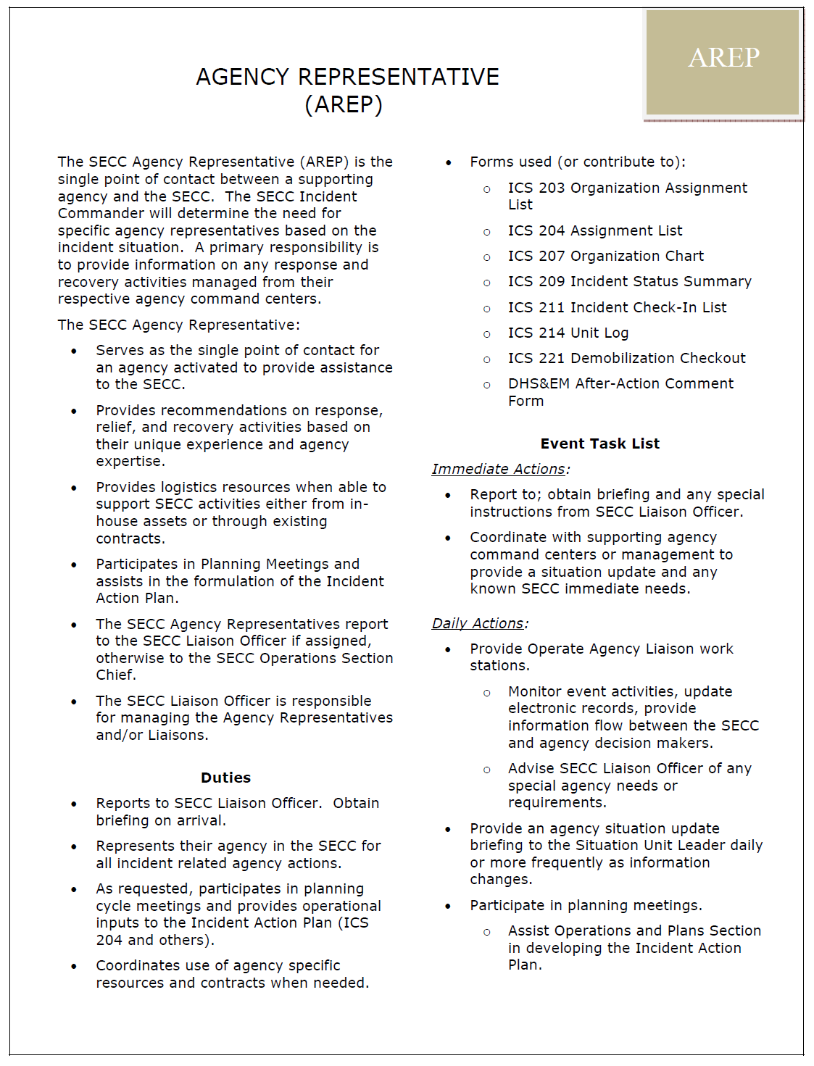
SECC Position Checklists
Checklists and other guidance has been developed to help liaisons understand their position in the SECC.
Checklists typically cover:
Responsibilities
ICS forms used
Immediate and daily duties
Section management and supervisory considerations
Demobilization
This guidance is located on the DHS&EM Intranet and can be sent to each liaison via pdf.

Slide 30
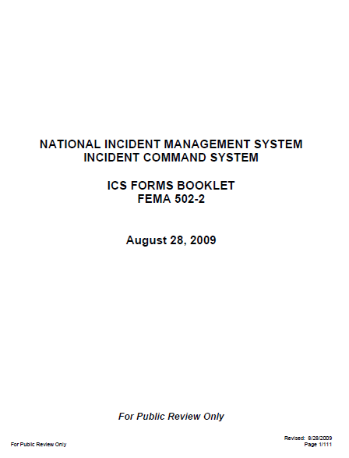
SECC Documentation
The SECC uses standard FEMA ICS terminology, positions, and forms:
The SECC uses the ICS Forms Booklet (FEMA 502-2) dated Aug 28, 2009
Liaisons should expect to provide regular input to the following ICS forms:
ICS 203 Organization Assignment List
ICS 204 Assignment List
ICS 207 Organization Chart
ICS 209 Incident Status Summary
ICS 211 Incident Check-In List
ICS 214 Unit Log
ICS 221 Demobilization Checkout
DHS&EM After-Action Comment Form

Slide 31
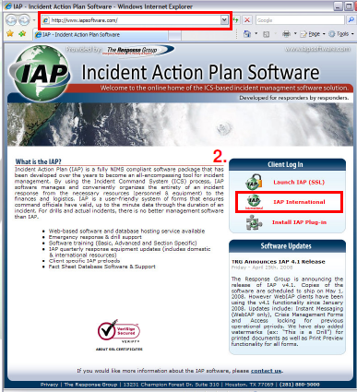
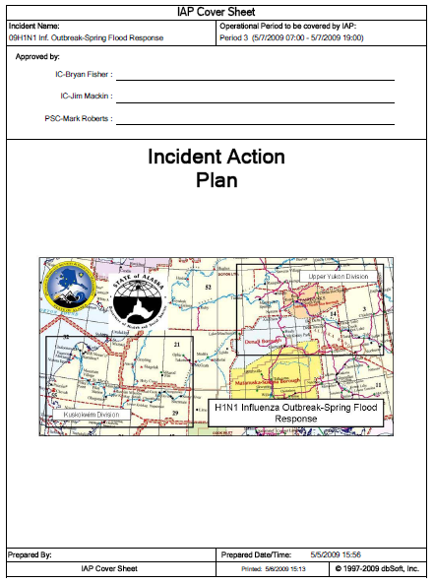
WebIAP™ Software and ICS Forms
The SECC uses the WebIAP software for development of incident action plans.
This software builds on standard FEMA ICS Forms and IAP formats
Introductory and focused training is provided on an as-needed basis

Slide 32
Scenario 1
You’ve been assigned as agency liaison to the SECC for this incident:
It’s August and a medium-sized city (approx. 1,000 residents) along the western Alaska coast has suffered a catastrophic fire that:
Destroyed the elementary school and high school with support facilities, to include most teacher housing. A total of 24 teachers and 400+ students are to begin school in three weeks.
Destroyed 14 private homes that housed 17 families consisting of 66 residents. There are approximately 240 homes in the community.
Damaged or destroyed several fuel tanks at a nearby tank farm.
Destroyed power lines in and around the school.
Destroyed the local ANICA village store and storage buildings.
Destroyed a front-end loader, school support truck, and fire equipment.
Required the long-term care, shelter and feeding of several residents

Slide 33
Scenario 1 Questions
Questions:
What agency information could you provide to SECC Operations upon your arrival?
What are your chief concerns?
What additional information do you need in order to help? Who would you ask?
What resources could you provide for the immediate (response), short-term (relief), or long-term (recovery) basis?
What challenges do you see in dealing with logistics, transportation, resource management, or public information?
How would your answers or approach change if the incident happened in October or January? What if the incident was caused by a fall sea storm, flood, or earthquake?
Notes:
October – fall sea storms, kids in school, colder weather, no barge traffic; village leaders at AFN; January – severe cold, kids in school,

Slide 34
Response, Relief, and Recovery Actions
Response (Immediate) | Relief (Short-term) | Recovery (Long-term)
Search and rescue Emergency shelter, housing, food, water, fuel, and energy Emergency medical and mortuary services Public health and safety Decontamination after a chemical, biological or radiological incident Removal of threats to the environment Emergency restoration of critical services (electric and natural gas services, water, sewer, telephone) Transportation, logistics, and other emergency services Private sector provision of needed goods and services through contracts or donations Secure crime scene, investigate and collect evidence Planning for relief and recovery | Provision of interim housing Repair and restoration of lifeline utilities Emergency repair of vital transportation systems Building safety inspections Debris removal and clean-up Provision of critical incident stress counseling for response staff and community Restoration of social/health services Restoration of normal civic services Coordination of local, state, borough, and federal damage assessments Re-occupancy of structures Economic recovery, including sites for business resumption Building demolition | Long term housing for displaced victims Debris management Hazard mitigation Reconstruction of permanent housing Reconstruction of commercial facilities Reconstruction of transportation systems Implementation of long-term economic recovery

Slide 35
2006 Hooper Bay Fire
SECC activated August 4 – 24, 2006
Liaisons involved: AKNG, DOT&PF, ARC,
VOADs, DEC (SPAR, DSW), DNR (DOF, SHPO),
DPS, DCCED, FEMA
FEMA Disaster DR-1666-AK, Oct. 27, 2006

Slide 36
Scenario 2
You’ve been assigned as agency liaison to the SECC for this incident:
It’s May and a small city and adjacent Native village (approx. 200 residents combined) along a major river in Alaska has suffered a catastrophic ice jam flood that:
Destroyed the majority of homes in the older portion of the Native village
Inundated and/destroyed the business district and several homes in the city
Inundated and damaged several city streets and airport access road and blocked the road connecting the two communities with debris
Severely damaged the city well and disrupted power to the village
Deposited debris and caused fuel tank spills throughout the community
Required the evacuation, shelter, and feeding of many city and village residents to the city school.
Required extensive search and rescue efforts for residents outside city/village limits.

Slide 37
Scenario 2 Questions
Questions:
What agency information could you provide to SECC Operations upon your arrival?
What are your chief concerns?
What additional information do you need in order to help? Who would you ask?
What resources could you provide for the immediate (response), short-term (relief), or long-term (recovery) basis?
What challenges do you see in dealing with logistics, transportation, resource management, or public information?
How would your answers or approach change if the incident happened in October or January?
Notes:
October – fall sea storms, kids in school, colder weather, no barge traffic; village leaders at AFN; January – severe cold, kids in school,

Slide 38
Response, Relief, and Recovery Actions
Response (Immediate) | Relief (Short-term) | Recovery (Long-term)
Search and rescue Emergency shelter, housing, food, water, fuel, and energy Emergency medical and mortuary services Public health and safety Decontamination after a chemical, biological or radiological incident Removal of threats to the environment Emergency restoration of critical services (electric and natural gas services, water, sewer, telephone) Transportation, logistics, and other emergency services Private sector provision of needed goods and services through contracts or donations Secure crime scene, investigate and collect evidence Planning for relief and recovery | Provision of interim housing Repair and restoration of lifeline utilities Emergency repair of vital transportation systems Building safety inspections Debris removal and clean-up Provision of critical incident stress counseling for response staff and community Restoration of social/health services Restoration of normal civic services Coordination of local, state, borough, and federal damage assessments Re-occupancy of structures Economic recovery, including sites for business resumption Building demolition | Long term housing for displaced victims Debris management Hazard mitigation Reconstruction of permanent housing Reconstruction of commercial facilities Reconstruction of transportation systems Implementation of long-term economic recovery

Slide 39
2009 Spring Floods
SECC activated May 3 – 25, 2009
Liaisons participating: AKNG, DOT&PF, ARC,
VOADs, DEC (DDW, SPAR), DNR (DOF), DPS,
DHSS (DPH), FEMA
FEMA Disaster DR-1843-AK, June 11, 2009
Eagle and Eagle Village were only two of 40 communities flooded in May 2009!

Slide 40
QUESTIONS????

