Slide 1
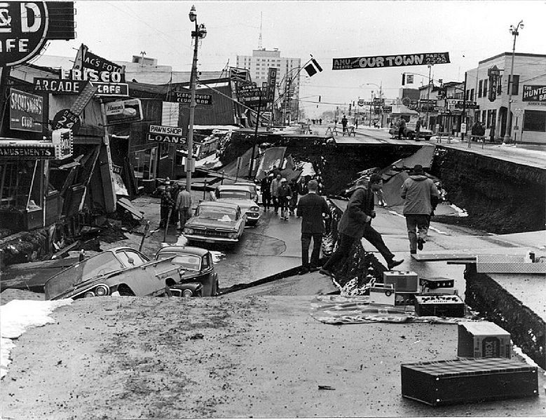
CHALLENGES IN DISASTER DEBRIS MANAGEMENT IN ALASKA
Claude Denver and George Coyle
DHS&EM Operations Section
October 6, 2011
Notes:
4th Street Damage, Anchorage, 1964

Slide 2
Questions To The Audience
Have you been involved in the clearing, removal, segregation, reduction, recycling, or disposal of disaster debris?
Does your community have a disaster debris management plan?
What is the current capacity of your landfill or dump?
What to you think would be the most significant challenges in debris management following a catastrophic disaster in your community?
Notes:
The third and fourth questions are ones to think about during the rest of the presentation.

Slide 3
Emergency Management Challenges In Alaska
Physiography and Hydrology
Demographics
Intra-State Travel Considerations, especially the use of small aircraft
Local Transportation Availability
Roads and Other Infrastructure
Weather
Emergency Services
Fresh Water
Sanitation
Domestic Waste Disposal
Heating in the Home
Subsistence Issues
Wildlife Considerations
Cultural/Language Considerations
Small Village Dynamics
Special Considerations

Slide 4
Demographics
State population (2010 census) = 710,231 in ~394 communities.
18 organized boroughs plus one “unorganized borough” that:
encompasses half the state-
has a population of 81,803, or 13% of the population of the state.

Slide 5
Seasonal and Weather Issues
Daylight and temperature ranges vary regionally and seasonally
Hurricane-force winds and resulting storm surges
Hard to predict level of impact or exact location of landfall of severe storms
Notes:
Weather
Typical winter weather statement by NWS
Hard to predict level of impact or exact location of landfall of severe storms
Temperatures vary regionally and seasonally from a record minus 82 degrees F in Bettles to 99 degrees F in Fairbanks.
Powerful storms (e.g., “pineapple express”) producing hurricane intensities occur each year.
Special weather events (e.g., Omega blocks) and Iwus also occur.
Daylight hours can range from all day during the summer to none in the winter in several communities.

Slide 6
Roads
Alaska’s transportation infrastructure may not easily accommodate a typical debris removal and disposal operation.
1,900 miles of interstate or principal artery roads
1,300 miles of principal artery marine highway
Some roads passable only during good weather or summer season

Slide 7
Local Considerations
Many city positions are volunteer or unfilled.
Local labor pool could be severely limited or unavailable.
Availability of equipment may be insufficient.
The actual cost of doing business in remote areas will need to be factored into your cost estimates.
Notes:
Annual elections each year rotate knowledgeable staff with new staff.
Seasonal movement of residents for fire crews, conference, hunting, fish camp, etc.
The high cost of living in the village can be surprising. Equipment and labor costs are high.
If equipment is not available locally, the cost of delivery and time delays will be significant. Fuel is regularly over $5/gallon.

Slide 8
Landfills and Dumps
Most communities have landfills or dumps – many unregulated.
Landfill space is a major concern
the community may not want their landfill filled up with disaster debris.
a new landfill site may not be found quickly.
Hazardous waste (e.g., fuel, chemicals, asbestos, etc) will need transport to a regulated facility outside the village.

Slide 9
Debris Management Issues From Recent and Past Events
Alaska
1964 Good Friday Earthquake
1994 Fall Flood
2005 West Coast Storm
2006 Hooper Bay Fire
2007 Kenai River Flood
2009 Spring Flood
2011 Birch Creek Fire
US and International
2010 Haiti Earthquake
2011 Japan Earthquake and Tsunami
2011 Joplin Tornado
2011 East Coast Flood

Slide 10
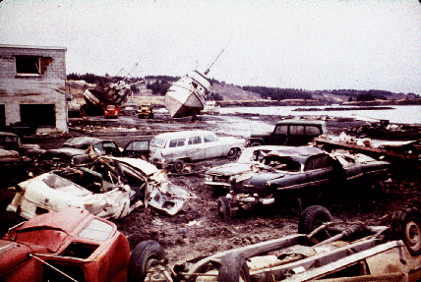
1964 Good Friday Earthquake
Property damage was estimated at over $310 million ($2.12 billion in current U.S. dollars).
Recovery pushed by the President who empowered a powerful, yet temporary results-driven, anti-red tape, entity.
The U.S. Army Corps of Engineers spent $110 million dollars (1964 dollars) rebuilding roads and clearing debris in Alaska.
In Anchorage, there were a few Informal waste dumps to handle derelict vehicles and disaster debris.
Notes:
131 dead from earthquake and tsunamis.

Slide 11
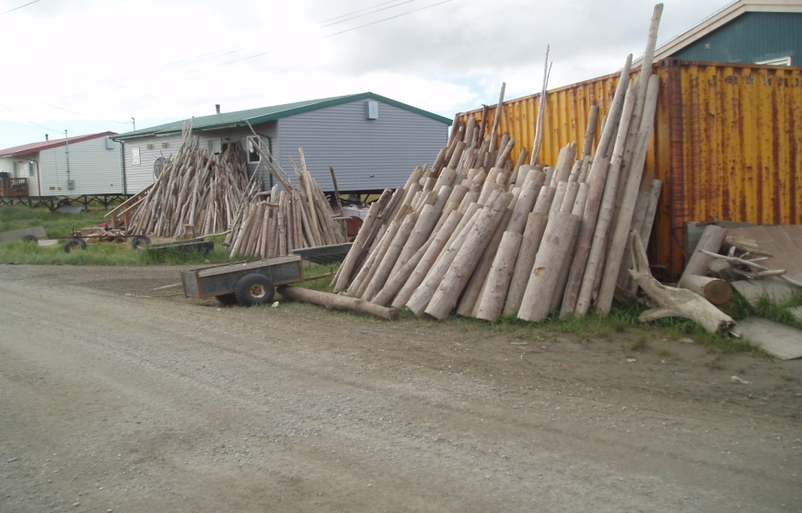
2005 West Coast Storm
Agency coordination with DEC and others.
Haz-Mat Management
Landfill not a good option
Woody debris was used by residents for home heating
Local debris management challenges
Notes:
September 2005 – 05 West Coast Sea Storm
DHS&EM Response and Recovery staff provided early warning to over 30 communities on the western coast of Alaska. This storm impacted roughly a similar area to the 2004 Bering Strait Sea Storm disaster. Response and Recovery staff also assisted Western Alaska community officials with life-safety and damage assessments after a large fall sea storm caused severe damage to coastal communities. This disaster is both a State- and Federally-declared disaster.

Slide 12
2006 Hooper Bay Fire
Agency conflict on debris disposal
State Historic Preservation Office considerations
Haz-Mat Management
Recycling and reuse issues
Crime scene
Barge use
Lack of available landfill space
Not in my back yard!
Notes:
DEC wanted to use local landfill. City did not want the long-term availability of the landfill compromised.
State Historical Preservation Officer (SHPO) concerns were raised when human remains were found on site.
Recycling and Haz-Mat debris were barged out of the community. This created a need for better logistical coordination.

Slide 13
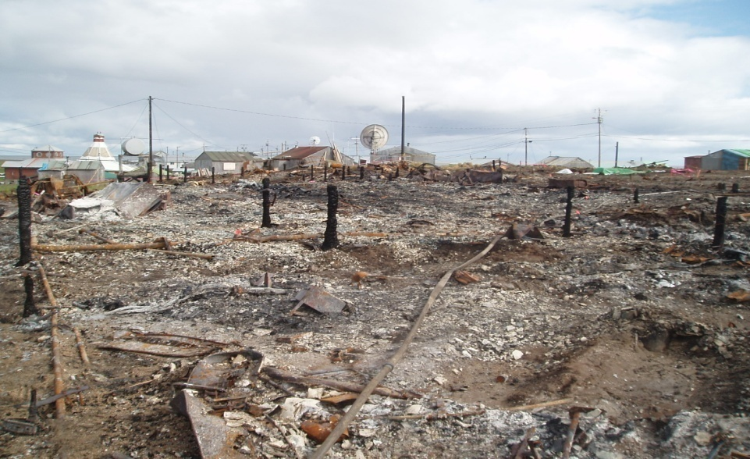
2006 Hooper Bay Fire
Before
After
Notes:
On August 3 - 4, 2006, the west-coast Alaska community of Hooper Bay (approx. 1,000 residents) suffered a catastrophic fire that:
Destroyed the elementary school and high school and support facilities, including most of the teacher housing. A total of 24 teachers and staff lost household and personal belongings. Approximately 400+ students were to begin school in three weeks.
Destroyed 14 private homes that housed 17 families consisting of 66 residents. There were approximately 240 homes in the community.
Damaged or destroyed several fuel tanks at a nearby tank farm.
Destroyed power lines in and around the school.
Destroyed the local ANICA village store and storage buildings.
Required the long-term care, shelter and feeding of several residents

Slide 14
2007 Kenai River Flood
Well established permitting entity available in community to guide removal/restoration efforts
Recycling and reuse issues – lots of recyclable material here
Seasonal issues created some problems

Slide 15
2009 Spring Flood - Eagle
Agency conflict on debris clearing of Mission Road
Haz Mat Management
Recycling and reuse issues
NRCS EWP Burn Trail use
Landfill coordination
Dead animals
Bldg demolition considerations
Local debris management challenges
USACE contractor brought in for debris management
Notes:
Beginning May 4 and continuing for several days, the City of Eagle and adjacent Native Village of Eagle (approx. 200 residents combined) suffered a catastrophic ice jam flood that:
Destroyed the majority of homes in the older portion of the Native village
Inundated and severely damaged or destroyed the business district and several homes along the city shoreline
Inundated and damaged several city streets and airport access road and blocked the road connecting the two communities with ice blocks and flood-related debris requiring construction of a temporary by-pass road
Contaminated the city well
Disrupted power to the village requiring temporary and emergency measures
Deposited debris and caused fuel tank spills throughout the communities
Required the evacuation, shelter, and feeding of many city and village residents to the city school.
Required extensive search and rescue efforts for residents outside city/village limits.

Slide 16
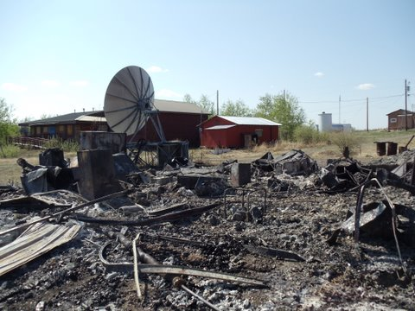
2011 Birch Creek Fire
Agency coordination with DEC and others.
Haz Mat Management – Asbestos, fuel spill, batteries.
Landfill not a good option
Bldg demolition considerations
Local debris management challenges
Contractor brought in for hazardous waste sampling, but not debris management
Notes:
The SECC was contacted by AST on May 26 that a fire had destroyed the power plant, tribal office, potable watering point, and telephone building in Birch Creek. A significant coordination and collaboration effort between DHS&EM, DEC, TCC, the Corporation, AST, and others ensued over the next two weeks. On June 2, DHS&EM received a local disaster declaration and request from the Tribe seeking State disaster assistance for emergency protective measures, temporary and permanent repairs to village infrastructure, and technical and funding assistance needed to repair or replace damaged facilities. DHSE&M sent one Operations staff to Birch Creek to inspect the damages and work with the community. A DPC was held June 17 to determine what assistance would be provided to the community; a decision by the Governor has not yet been made as of July 14. Governor Parnell declared a limited state disaster for the community on August 9, 2011.

Slide 17
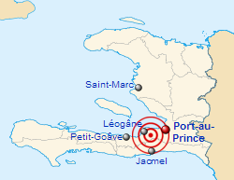
2010 Haiti Earthquake
Only about 2% of the estimated 33 million cubic yards of debris generated by the 7.0 M quake last January 12, 2010 had been cleared as of September 2010.
Problems to overcome included:
Heavy equipment had to shipped in by sea.
Dump trucks had trouble operating on small dirt roads.
There are few sites to dump the rubble.
The Government doesn’t have good property ownership records.
There is no single Government official (i.e., a “rubble czar”) in charge of clearing the rubble.
Government officials as well as the public are “frustrated” with the slow progress.
Notes:
Projects funded by USAID and the U.S. Department of Defense have spent more than $98.5 million to remove 1.2 million cubic yards of rubble.

Slide 18
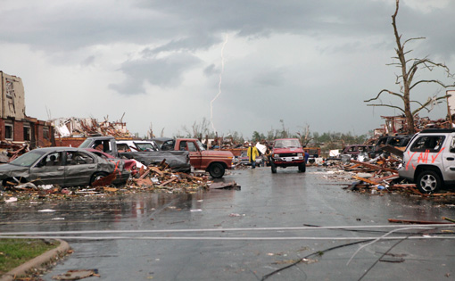
2011 Joplin Tornado
Storm debris-removal efforts for public streets and curbsides in the City of Joplin and surrounding areas began June 1
Debris-removal efforts managed by the U.S. Army Corps of Engineers with authorized subcontractors through a mission assignment from FEMA.
On July 26, Gov. Jay Nixon requested that FEMA extend the Expedited Debris Removal Program that is scheduled to end Aug. 7
The state has agreed to pay all 25% of the non-federal share debris removal costs after this date. Joplin was to pay 12.5% of the costs.
Notes:
Tornado happened May 22. Killed 140 people.

Slide 19
2011 Hurricane Irene
Landfall was early on August 27 in North Carolina.
Widespread damage from the Outer Banks of North Carolina to the flooded hills of Vermont.
Dozens of people died.
Knocked out power to 3.3 million homes and businesses along the U.S. East Coast, forced two nuclear plants to shut down.
Several New Jersey and Vermont communities are still struggling with severe flooding, while North Carolina residents pick up the pieces of their lives.
Estimated damages likely as high as $7 billion.
Notes:
On May 27, 2011, Governor Peter Shumlin requested a major disaster declaration due to severe
storms and flooding beginning on April 23, 2011, and continuing. The Governor requested a
declaration for Individual Assistance for nine counties, Public Assistance for 10 counties, and
Hazard Mitigation statewide. On June 15, 2011, President Obama declared major disaster FEMA-1995-DR as a result of
severe storms and flooding during the period of April 23 to May 9, 2011. Then on July 8, 2011,
President Obama declared that a major disaster exists in the State of Vermont as a result of
severe storms and flooding during the period of May 26-27, 2011.

Slide 20
2011 Japan Earthquake and Tsunami
Just because your community didn’t have a tsunami doesn’t mean you won’t have to deal with debris.
The largest "island" of debris stretches 60 nautical miles (69 miles) and covers more than 2.2 million square feet, according to the US Navy.
It may take up to two years for the floating tsunami debris to hit Hawaii and three years for the West Coast

Slide 21
Questions???
State Emergency Coordination Center
(800) 478-2337 (24 hours)
Claude E. Denver or George Coyle (907) 428-7100
claude.denver@alaska.gov
George.coyle@alaska.gov

