Slide 1
Grant Program Kick-Off Meeting
How to have a successful SLCGP grant!
Notes:
________________________________________________________________
________________________________________________________________
________________________________________________________________
________________________________________________________________
________________________________________________________________
________________________________________________________________

Slide 2
Agenda
Introductions
Topics of Discussion
2022 Grant Funding
Award Process
Grant Terms and Conditions
Reporting
Procurement Process
Feedback
Questions and Answers
Notes:
________________________________________________________________
________________________________________________________________
________________________________________________________________
________________________________________________________________
________________________________________________________________
________________________________________________________________

Slide 3
Grant Funding
Federal Year (FY) 2022
$2,494,425.56 90/10
Awarding $968,814.65
Remaining $1,026,725.79
Federal Year (FY) 2023
$4,567,677 – Federal Portion
$1,141,919.25 – Required Match
80/20 – Currently anticipating the State will provide the match, dependent on the approved state budget

Slide 4
Award Process
SLCGP -
Staff Analysis
Review for Eligibility
Grade Each Application
Application Complete?
Past Performance
Notes:
________________________________________________________________
________________________________________________________________
________________________________________________________________
________________________________________________________________
________________________________________________________________
________________________________________________________________

Slide 5
Award Process - SLCGP
Internal Review Committee
Emergency Management, Project Manager, and Grants Management. Reviewed by corresponding staff section employees and asked to provide feedback on the project.
External Review Committee
Interagency Review Committee. Comprised of local subject matter experts from all over the State.
Leadership and Director Approval
Notes:
________________________________________________________________
________________________________________________________________
________________________________________________________________
________________________________________________________________
________________________________________________________________
________________________________________________________________

Slide 6
Award Process
External Review Committee
Interagency Review Committee. Comprised of local subject matter experts from all over the State.
Unable to hold due to timing and weather
Prioritized Risk Assessments, Training, and Multi-Factor Authentication.
Leadership and Director Approval
Submit to FEMA for review, approval, and release of funding hold.
Notes:
________________________________________________________________
________________________________________________________________
________________________________________________________________
________________________________________________________________
________________________________________________________________
________________________________________________________________

Slide 7
Risk Assessments
Per 2 CFR 200.332 Federal awarding agency review of risk posed by the applicant
“b) Evaluate each subrecipient’s risk of noncompliance with Federal statutes, regulations, and the terms and conditions of the subaward.”
Factors that help determine your risk
Amount and Complexity of grant
Financial and Accounting system
Prior Performance
New Staff Changes
Audit Findings

Slide 8
Award Process slcgp
Federal Grant Number: EMW-2022-CY-00038-S01
CFDA Number: 97.137
State Grant Number: 22SLCGP-GY22
Jurisdiction Start Date: February 1, 2024
Jurisdiction Ending Date: December 31, 2025
Jurisdiction Final Report Due: February 15, 2026
Notes:
________________________________________________________________
________________________________________________________________
________________________________________________________________
________________________________________________________________
________________________________________________________________
________________________________________________________________

Slide 9
Award Process
Upon Receipt of Award:
Review all pages of the award for accuracy in information
Primary (only) Signatory Authority Officer (SAO) Signed Obligating Award
The Primary Signatory Authority Officer, Program Manager, and Financial Officer signed the last page of Program Terms and Conditions (all three signatures must be the Primary signatories)
Complete Intent to Accept Award if acceptance exceeds 30 days past receipt of the award
Review the Signatory Authority Form for any Updates
Review Project Budget Details
Notes:
________________________________________________________________
________________________________________________________________
________________________________________________________________
________________________________________________________________
________________________________________________________________
________________________________________________________________

Slide 10
Award Process
Acceptance:
Jurisdiction must sign and return the award within 30 days from certified receipt.
Requires one (1) signature on the first page of the award
Requires three (3) signatures on acceptance of grant requirements, assurances, and agreements
Completion of new Signatory Authority Form, if needed
If additional approval is required
Submit the “Notice of Intent to Accept Grant Award” form
DHS&EM will provide approval notification
Notes:
________________________________________________________________
________________________________________________________________
________________________________________________________________
________________________________________________________________
________________________________________________________________
________________________________________________________________

Slide 11
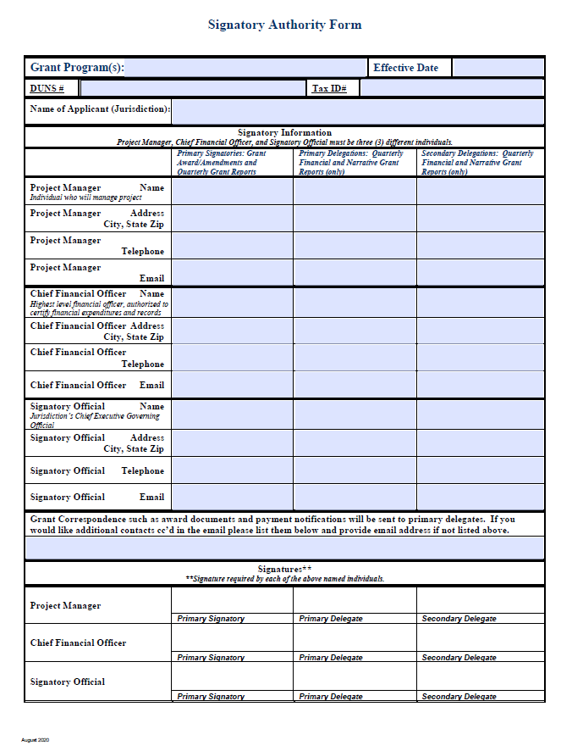
Award Process
Signatory Authority Form:
Allows for up to two (2) delegates
The Project Manager cannot be a delegate for the Chief Financial Officer or Signatory Authority.
Changes in primary signature authorities will require an amendment to award.
Signatory changes on quarterly reports and award documents will not be accepted without an updated Signatory Authority Form.
There is a box to list any contacts you would like cc’d on all grant related correspondence.
Notes:
________________________________________________________________
________________________________________________________________
________________________________________________________________
________________________________________________________________
________________________________________________________________
________________________________________________________________

Slide 12
Award Process
Project Budget Details (PBD):
Shows approved projects from the Review Process
Demonstrates allocation of funds, not pre-approval or authorization of expenses
Current PBD can be requested at any time.
Will be updated if projects are canceled, funds are increased or decreased, or reallocated projects added
No transfer of funding between budget categories allowed
Unexpended funds will be de-obligated
Notes:
________________________________________________________________
________________________________________________________________
________________________________________________________________
________________________________________________________________
________________________________________________________________
________________________________________________________________

Slide 13
Grant Terms and Conditions - Slcgp
No commingling of funds
No funds will be reimbursed until representatives attend a SLCGP Grant Kick–Off Meeting to be held electronically in April 2024. Activity toward grant acceptance and projects may take place prior to Kick-Off meeting attendance.
Must complete a Quarterly Activities Plan by July 20, 2024.
Cyber Hygiene Services by December 31, 2024.
Complete the Nationwide Cybersecurity Review (NCSR) by December 31, 2024.
Notes:
________________________________________________________________
________________________________________________________________
________________________________________________________________
________________________________________________________________
________________________________________________________________
________________________________________________________________

Slide 14
Grant Terms and Conditions - SLCGP
2022 SLCGP Quarterly Activities Plan
Under Grants Requirements, Assurances and Agreements:
Must complete a Quarterly Activities Plan by July 20, 2024. This is to ensure project milestones can be reported to FEMA in a timely manner.
Instructions - Provide milestones for each PBD#.
This is meant to cover the entire grant performance period and it not meant to be done on a quarterly basis.
If there are delays a new plan needs to be submitted to update milestones.
Notes:
________________________________________________________________
________________________________________________________________
________________________________________________________________
________________________________________________________________
________________________________________________________________
________________________________________________________________

Slide 15
Grant Terms and Conditions
Equipment Inventory
Annual inventory report due June 20 regardless of grant recipient status
All equipment over $5,000 and useful life of greater than 1 year
Disposition of excess property/equipment if over $5,000- Use Disposition of Equipment Form
Notes:
________________________________________________________________
________________________________________________________________
________________________________________________________________
________________________________________________________________
________________________________________________________________
________________________________________________________________

Slide 16
Grant Terms and Conditions – SLCGP
Complete the Nationwide Cybersecurity Review (NCSR) by December 31, 2024.
Online, no-cost, annual self-assessment designed to measure gaps and capabilities of state, local, tribal, and territorial governments’ cybersecurity programs.
Registration at www.cisecurity.org/ms-isac/services/ncsr
NCSR staff will contact you with completing registration and review.
FAQs and User Guides assist in completing this requirement.
Should be completed by personnel responsible for cybersecurity within your organization.

Slide 17
Grant Terms and Conditions – SLCGP
Complete the Cyber Hygiene Services by December 31, 2024.
Designed specifically for vulnerability scanning and web application scanning.
Registration for this service by emailing vulnerability@cisa.dhs.gov with the subject line “Requesting Cyber Hygiene Services – SLCGP” to get started. Indicate in the body of the email that you are requesting this service as part of the SLCGP.
Should be completed by personnel responsible for cybersecurity within your organization.
For more information, visit CISA’s Cyber Hygiene Page at https://www.cisa.gov/cyber-hygiene-services

Slide 18
Reporting
SLCGP Start Date: February 1, 2024
First quarterly report is waived
Second quarterly report is due July 20, 2024
SLCGP End Date: December 31, 2025
Last quarterly report due January 20, 2026
Must show activity within the second Quarter
Notes:
________________________________________________________________
________________________________________________________________
________________________________________________________________
________________________________________________________________
________________________________________________________________
________________________________________________________________

Slide 19
Quarterly Grant Reporting
SLCGP Performance Progress Report
Two (2) parts
Narrative Summary
Place quarterly comments here, do not leave blank
Program Indicators
Must report expenses, list Project Budget Detail number
Put amount requested for reimbursement per project
This should support the request for reimbursement on the financial report
Project Manager and Signatory Official (delegate) must sign form
Notes:
________________________________________________________________
________________________________________________________________
________________________________________________________________
________________________________________________________________
________________________________________________________________
________________________________________________________________

Slide 20
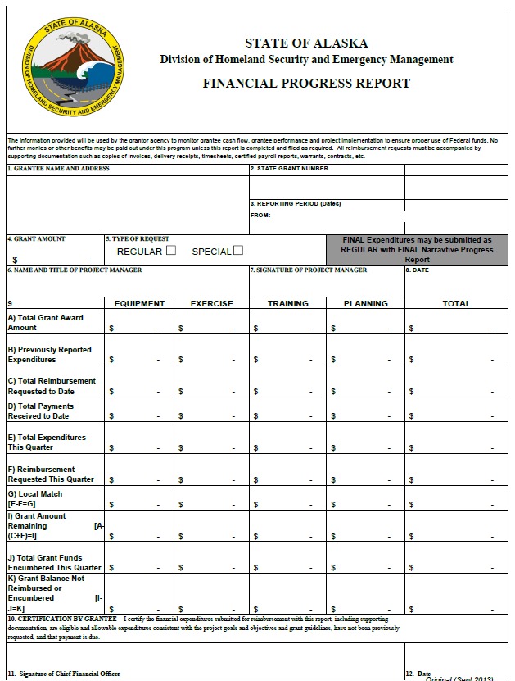
Quarterly Reporting
SLCGP Financial Progress Report and Request for Reimbursement
Invoice – must include the corresponding PBD #
Proof Payment Cleared with expenses- transaction ledger, copy of canceled checks, etc.
Must Submit Procurement Method Report with each procurement
Must Submit Single Equipment Reporting Form with equipment purchases at the time of reimbursement (eq $5k and over)
The Project Manager and Financial Officer (or delegate) must sign the form
Notes:
________________________________________________________________
________________________________________________________________
________________________________________________________________
________________________________________________________________
________________________________________________________________
________________________________________________________________

Slide 21
Quarterly Grant Reporting
Most importantly, make sure you send in a complete Quarterly Report package on time
Late reports affect application scores and risk assessments on all future grants
Incomplete packages delay reimbursements
There is a Quarterly Report Package Checklist for your use
Provides a checklist of how to complete reports and all documentation that needs to be attached
If we request additional items to process the report and they are not received within 2 weeks of the request the costs will be disallowed.
Notes:
________________________________________________________________
________________________________________________________________
________________________________________________________________
________________________________________________________________
________________________________________________________________
________________________________________________________________

Slide 22
Reporting
Final Reports
Due 45 days after the performance period ends
SLCGP February 15, 2026
Does not replace the last quarterly report for SLCGP grants
Dates should cover the entire performance
Report should discuss how the grant projects have helped the community
Are tailored for each Subrecipient for the SLCGP grant.
All encumbered expenditures must be paid within 45 days after the end of performance period
Financial Report does not need to be completed if all funds have been expended and reimbursed through quarterly reports.
Notes:
________________________________________________________________
________________________________________________________________
________________________________________________________________
________________________________________________________________
________________________________________________________________
________________________________________________________________

Slide 23
Financial Backup
SLCGP - What to submit for most purchases
Invoice
Invoice/Confirmation Number
Items Purchased
Date of Order/Purchase
How Purchase was Paid
PBD# should be written on the invoice
Equipment training
Must be included with the procurement of equipment
Maintenance contracts and software licenses
Encouraged to procure with equipment
Must be in budget
Notes:
________________________________________________________________
________________________________________________________________
________________________________________________________________
________________________________________________________________
________________________________________________________________
________________________________________________________________

Slide 24
Financial Backup
SLCGP - What to submit for most purchases (cont.)
What to Submit for Reimbursement of Travel
A copy of the flight or travel itinerary is required
(Boarding passes not required, unless proof for a day trip)
Hotel invoice/receipt- Please do not submit only reservation confirmation if there is no amount due on the confirmation. The amount due must match the proof of payment cleared documentation.
Lodging rate before fees and taxes cannot exceed the max federal rate. (Example: Anchorage is $99.00 winter, $339.00 summer)
Per Diem - Use local policy, but cannot exceed federal rate and 75% of rate on first and last travel days – Documentation of payment to traveler required
Rental cars at jurisdiction discretion
Notes:
________________________________________________________________
________________________________________________________________
________________________________________________________________
________________________________________________________________
________________________________________________________________
________________________________________________________________

Slide 25
Financial Backup
SLCGP - What to submit for most purchases (cont.)
What to Submit for Reimbursement Overtime and Backfill
Summary spreadsheet of timesheets listing employee name, name of employee for whom backfilled if applicable, date worked, hours worked, rate of pay distinguished by straight time and/or overtime, total wages, fringe benefit cost.
This must be signed and certified
When reimbursing backfill-
You must track who the individual being backfilled and their respective backfill replacement. This will need to be documented accordingly when seeking reimbursement.
The overtime rate for the backfill person must never exceed the overtime rate of the individual being backfilled
Notes:
________________________________________________________________
________________________________________________________________
________________________________________________________________
________________________________________________________________
________________________________________________________________
________________________________________________________________

Slide 26
Financial Backup
Procurement Documentation
*Local procurement policies may be used, but they must be as stringent as state or federal policy
Procurement Method Report (PMR) – this is used to document the procurement process
This must be submitted with every invoice/receipt (except for travel related costs and advertising). Ensure one PMR is being completed per purchase/order (this may cover more than one invoice) DO NOT FRAGMENT!
Use the correct form per the corresponding Procurement amount –
$0.00 – under $10,000 – Sign certification
$0.00 - under $10,000.00
 | Vendor Name: | Purchase Amount:
Justification for Vendor Selection. Please include any written supporting documents providing justification for vendor selection. “Vendor was procured by Micro Purchase in accordance with local, state and federal procurement methods and to the maximum extent practicable, we attempted to distribute micro-purchases equitably among qualified suppliers. Where micro-purchases were awarded without soliciting competitive price or rate quotations, it was only under the condition that we considered the price to be reasonable based on research, experience, purchase history and/or other information and documents. We have filed this documentation accordingly.”
Notes:
________________________________________________________________
________________________________________________________________
________________________________________________________________
________________________________________________________________
________________________________________________________________
________________________________________________________________

Slide 27
Financial Backup
Procurement Documentation (cont.)
Procurement Method Report – this is used to document the procurement process (cont.)
The following require Pre-Approval before purchase. Use the correct form per the corresponding Procurement amount
$10,000.00 – under $100,000 – Provide Specifications on what is being purchased, criteria for awarding the purchase, and the response due date that was provided to the vendors. Three vendors with bid amounts must be listed. Complete the justification box on why the vendor was selected, sign, and send in for pre-approval before making the purchase.
$100,000.00 or greater – Requires two pre-approvals. Complete the first section of the PMR and provide all draft Request for Proposal, or Invitation to Bid documentation to DHS&EM before advertising. Once approved by a DHS&EM Program Manager, it will be sent back to advertise the procurement. Once responses are received, complete the rest of the form and send to DHS&EM for approval before awarding the purchase.
Pre-Bid Contracts – This includes GSA, NASPO or local equivalents. Complete the form, sign, and send to DHS&EM prior to making the purchase.
Sole Source/Inadequate Competition – This is not the same as a pre-bid contract. Complete the form ensuring to provide justification and evidence as to why this type of procurement is being used. Sign and send the DHS&EM before making the purchase.

Slide 28
Financial Backup
SAM Report
Every vendor must be checked on the sam.gov website
If the vendor does not appear print the screen showing you searched
Notes:
________________________________________________________________
________________________________________________________________
________________________________________________________________
________________________________________________________________
________________________________________________________________
________________________________________________________________

Slide 29
Financial Backup
Proof Payment Cleared
For items paid for by cash
1. Invoice/receipt marked paid in full or documents a complete cash transaction (e.g., the change provided back, the amount still due $0.00, etc.)
For items paid for by check or Electronic Transfer-
1. Invoice/receipt- preferably with check number on it
2. Copy of canceled check (front and back) or copy of automated transaction ledger showing outlay of funds, or copy of bank statement
For items paid for by credit card
1. Invoice/copy or receipt
2. A copy of the credit card statement with the charge
Notes:
________________________________________________________________
________________________________________________________________
________________________________________________________________
________________________________________________________________
________________________________________________________________
________________________________________________________________

Slide 30
Reallocation of Funds - SLCGP
As money is turned back by jurisdictions these fund go into a pot to later be reallocated back out in order to maintain the 80% pass through requirement on the grant.
The application is on the website and can be completed at anytime and submitted to mva.grants@alaska.gov. We will sometimes send out an e-mail asking for applications if we have a large pot of money to reallocate.
Priority for funding projects is:
Underfunded projects / Cost Over-Runs
New Projects
National Priority Projects
Often times these funds must be accepted and spent in a very short timeframe so please keep this in mind when completing the reallocation application.
Notes:
________________________________________________________________
________________________________________________________________
________________________________________________________________
________________________________________________________________
________________________________________________________________
________________________________________________________________

Slide 31
The Way Ahead - SLCGP
February 2024
SLCGP Local Grant Application, State Overview, and Guidelines available
March 29, 2024
Electronically Submit Grant Applications to DHS&EM, NLT 11:59 pm Friday, March 29, 2024
April 2024
DHS&EM Grants review of applications for eligibility
DHS&EM Internal Staff review for comments on feasibility, capability, and reasonableness
June 2024
DHS&EM Writes Project Worksheets and submits to USDHS for funding hold release
September-October 2024
Funding notification sent out to all applicants
DHS&EM e-mails awards to subrecipients (NLT 45 days after official hold release notification)
October-November 2024
Grant Kick-Off Meetings held with Subrecipients
Interagency Review committee held to determine funding recommendations
May 21-23, 2024
July-August 2024
DHS&EM receives release of funds from USDHS
Grants webinar will be held for interested jurisdictions.
Notes:
________________________________________________________________
________________________________________________________________
________________________________________________________________
________________________________________________________________
________________________________________________________________
________________________________________________________________

Slide 32
Questions & Answers
http://ready.alaska.gov/grants.htm
1-800-478-2337
or 907-428-7000
Email: mva.grants@alaska.gov
Notes:
________________________________________________________________
________________________________________________________________
________________________________________________________________
________________________________________________________________
________________________________________________________________
________________________________________________________________

