Slide 1

Nonprofit Security Grant Program- State (NSGP-S)
Notes:
________________________________________________________________
________________________________________________________________
________________________________________________________________
________________________________________________________________
________________________________________________________________
________________________________________________________________

Slide 2
Agenda
Introductions
Topics of Discussion
What is it?
Grant Funding
Who can apply
What’s Eligible
Timeline
Application Process, Documents, and Due Dates
Requirements if Awarded
Q&A

Slide 3
What is it?
The Nonprofit Security Grant Program provides funding support for target hardening and other physical security enhancements and activities to nonprofit organizations that are at high risk of a terrorist attack. The program seeks to integrate nonprofit preparedness activities with broader state and local preparedness efforts. It is also designed to promote coordination and collaboration in emergency preparedness activities among public and private community representatives, as well as state and local government agencies.

Slide 4
Grant Funding
Target allocation for FY 2024 is $1,282,500
Notes:
________________________________________________________________
________________________________________________________________
________________________________________________________________
________________________________________________________________
________________________________________________________________
________________________________________________________________

Slide 5
Who’s Eligible?
Eligible subapplicants for this program must meet the definition of nonprofit organization described under section 501(c)(3) of the Internal Revenue Code of 1986 (IRC) and exempt from tax under section 501(a) of such code;
AND: Be able to demonstrate, through application, that the organization is at high risk of a terrorist or other extremist attack;
AND: Be located outside of a UASI- designated urban area (all nonprofits physically in Alaska meet this requirement);
AND: The organization must agree to comply with the standards, regulations, and requirements applicable to subrecipients receiving pass-through subawards found in 2 CFR Part 200—Uniform Administrative Requirements, Cost Principles, and Audit Requirements for Federal Awards
Notes:
________________________________________________________________
________________________________________________________________
________________________________________________________________
________________________________________________________________
________________________________________________________________
________________________________________________________________

Slide 6
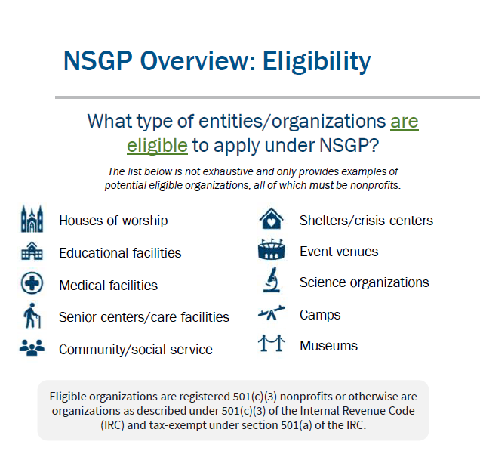
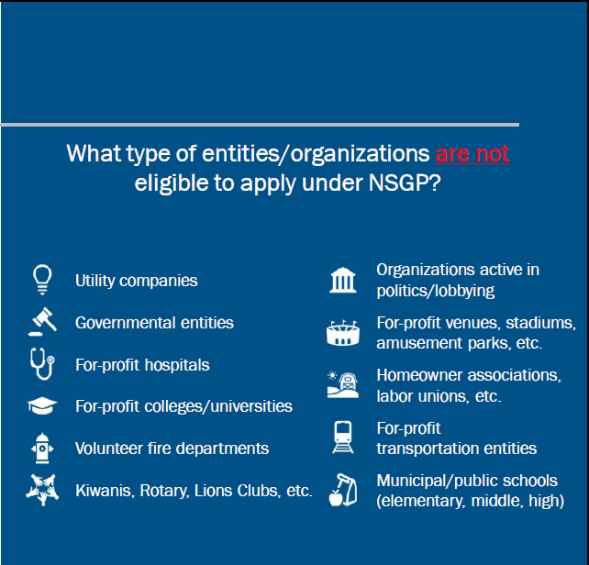
Who’s Eligible?

Slide 7
What’s Eligible?
Each subapplicant may apply for up to $150,000 in the form of an Investment Justification (IJ). The IJ must describe each investment proposed for funding and all of the below:
Be for the location(s)/physical address(es) (NOT P.O. Boxes) that the nonprofit occupies at the time of application;
Address an identified risk, including threat and vulnerability, and build or sustain a core capability identified in the National Preparedness Goal
Demonstrate the ability to provide enhancements consistent with the purpose of the program and guidance provided by DHS/FEMA
Be both feasible and effective at reducing the risks for which the project was designed
Be able to be fully completed within the two-year period of performance
Note:
No more than 3 locations per Non-Profit!
Each location must be a separate IJ!
Notes:
________________________________________________________________
________________________________________________________________
________________________________________________________________
________________________________________________________________
________________________________________________________________
________________________________________________________________

Slide 8
What’s Eligible? (cont.)
Security Related Projects:
Planning: Must be related to the protection of the facility and the people within.
Training: Security related training for security personnel and for nonprofit employees, members, congregants, and volunteers.
Contracted security personnel
Exercises: Plan and conduct security-related exercises.
Equipment: Facility hardening and physical security enhancements.
Notes:
________________________________________________________________
________________________________________________________________
________________________________________________________________
________________________________________________________________
________________________________________________________________
________________________________________________________________

Slide 9
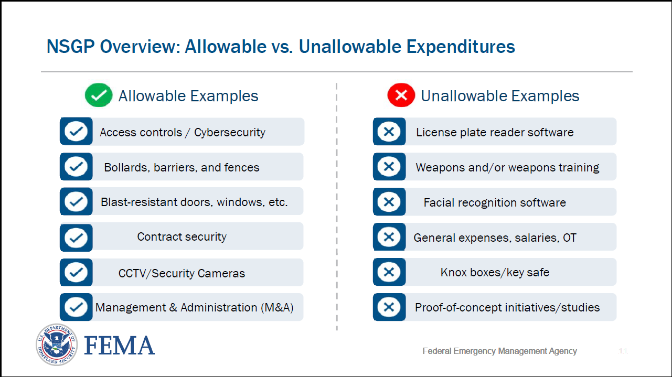
Allowable vs. unallowable

Slide 10
FFY 2024 Projected Timeline
The FFY 2024 Federal Notice of Funding Opportunity (NOFO) released
Completed Application due to mva.grants@alaska.gov on May 31st
State submits federal application by June 24th
Projected Period of Performance 10/1/24 – 9/30/26
Applications for review and feedback due to mva.grants@alaska.gov by May 16th
State receives federal award by September 30th

Slide 11
Application - Process
1. FEMA Release’s Notice of Funding Opportunity and Investment Justification Form with the application deadline for the State (NOT the nonprofit).
2. DHS&EM will create its overview and guidelines with additional information and requirements.
3. DHS&EM sends out an email notification that the application is open and that non-profits have a different/earlier deadline to submit.
4. Applications must be submitted to DHS&EM at mva.grants@alaska.gov
5. DHS&EM reviews, scores and prioritizes applications for submittal to FEMA by application deadline.
6. FEMA reviews and determines project funding.
Notes:
________________________________________________________________
________________________________________________________________
________________________________________________________________
________________________________________________________________
________________________________________________________________
________________________________________________________________

Slide 12
Application - Documents
1. Investment Justification Application Form
2. Vulnerability Assessment/Risk Assessment specific to the facility being applied for.
3. Mission Statement - Each subapplicant must include its Mission Statement and any mission implementing policies or practices that may elevate the organization’s risk. SAAs will use the Mission Statement along with information provided in the subapplicant’s IJ in order to validate the organization is one of the following types: 1) Ideology-based/Spiritual/Religious; 2) Educational; 3) Medical; or 4) Other.
4. Signatory Authority Form with required three (3) signatures for organization.
5. If applicable, any Memorandum of Understanding (MOU), or Memorandum of Agreement (MOA) related to inter-agency projects.
Notes:
________________________________________________________________
________________________________________________________________
________________________________________________________________
________________________________________________________________
________________________________________________________________
________________________________________________________________

Slide 13
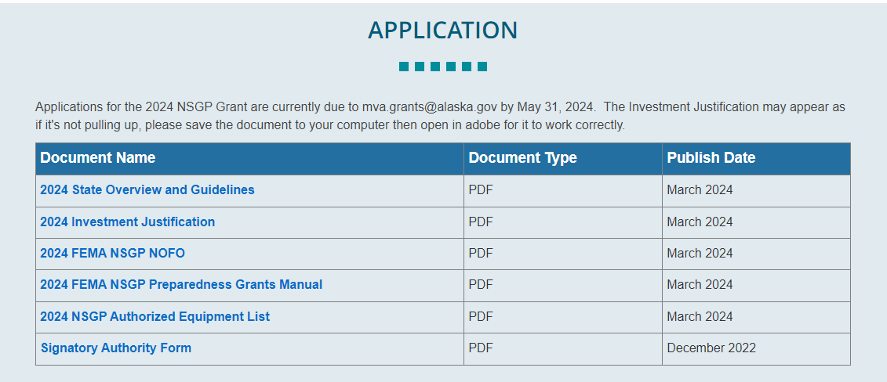

Application – Investment Justification
When you click on the IJ link on our website it will open a new tab and appear like the below image. You will need to click on the save icon.

Slide 14
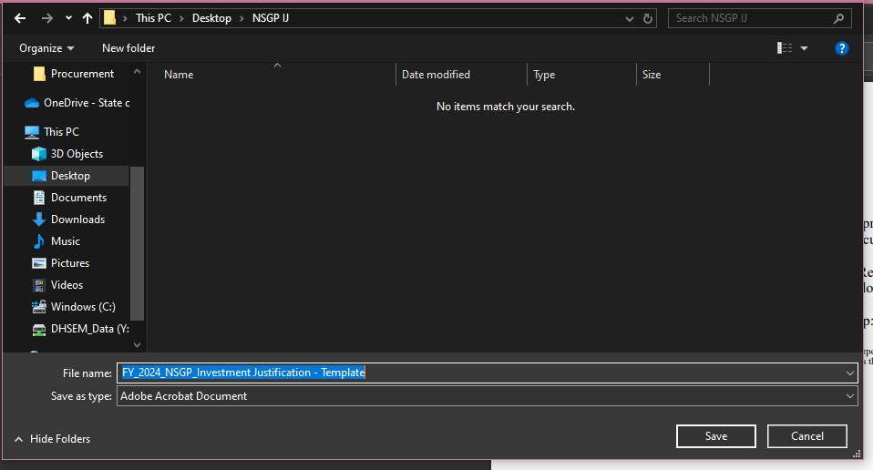
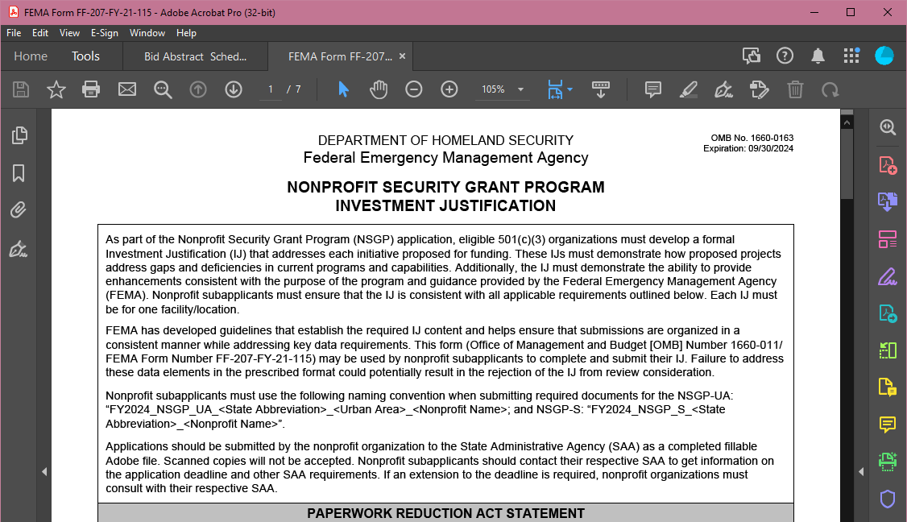
Application – IJ (Cont.)
Save the IJ on your computer. Then once you open the IJ from that saved location it will appear like the below image.
The IJ will not open correctly in a web browser and must be opened from your computer in Adobe.

Slide 15
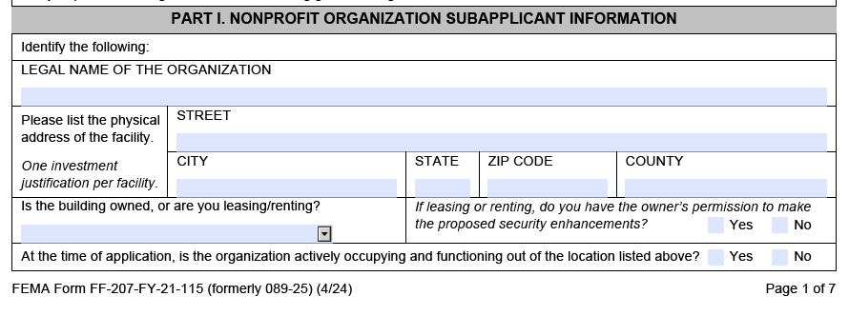
Application – IJ Organization

Slide 16
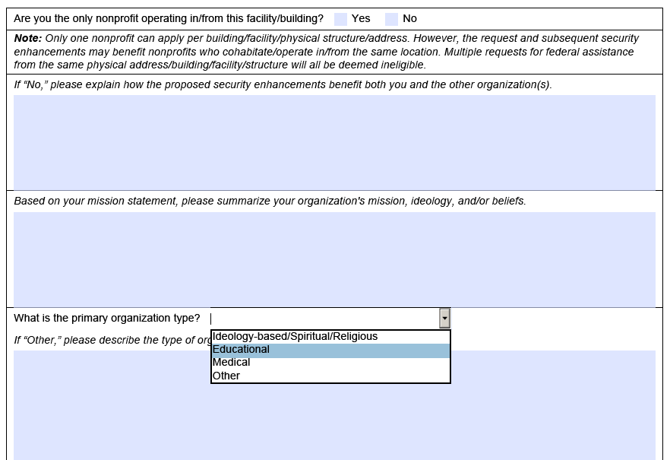
Application – IJ Organization (Cont.)
  Best Practices
    Answer all required questions
    Describe but be concise
  Common Pitfalls
    Being vague or assuming reviewer knows
    Not answering

Slide 17
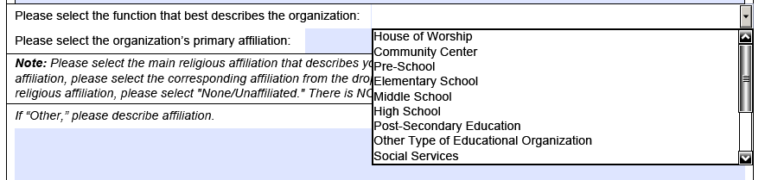
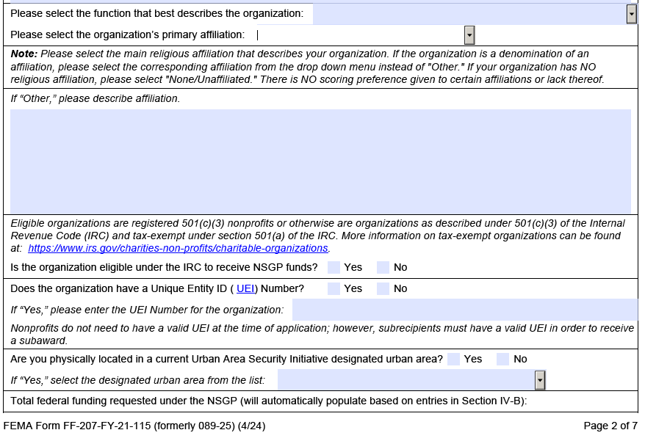
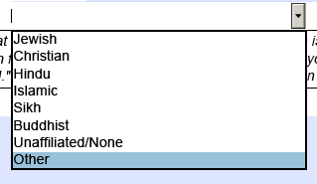
Application – IJ Organization (Cont.)

Slide 18
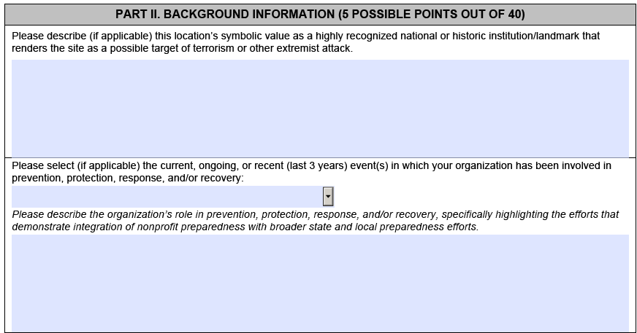
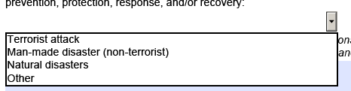
Application – IJ Background

Slide 19
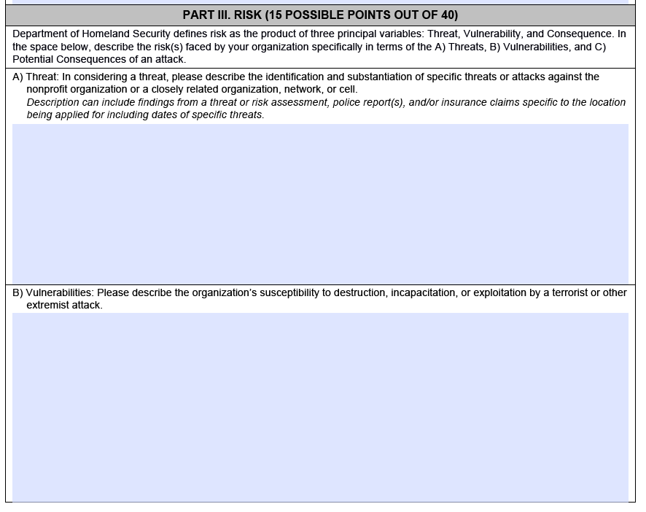
Application – IJ Risk
  Best Practices
    Answer each separately
    Be concise
  Common Pitfalls
    Being vague or assuming the reviewer knows
    Not answering
    Answers should not be the same

Slide 20
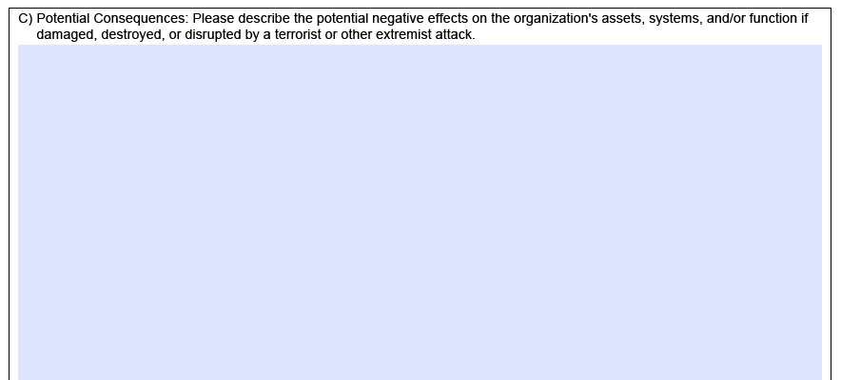
Application – IJ Risk (Cont.)

Slide 21
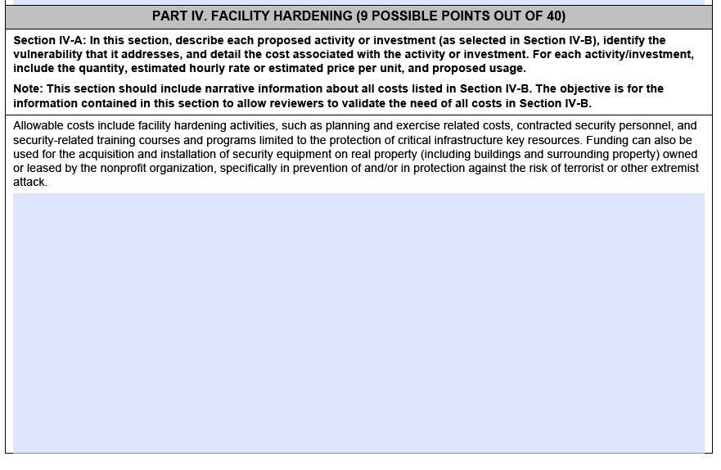
Application – IJ Facility Hardening
  Best Practices
    Describe each project separately
    Address each aspect for each project
    Be concise!
  Common Pitfalls
    Being vague or assuming the reviewer knows
    Not answering

Slide 22
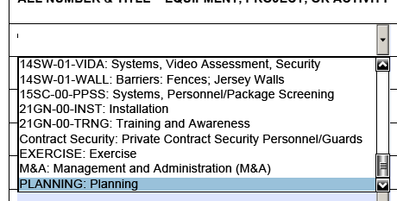
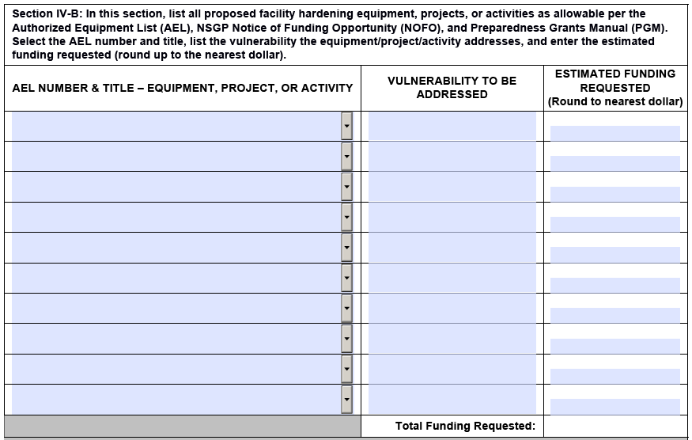
Application – IJ Facility Hardening (cont.)
This section must line up with the described projects from previous section.
If you include M&A it can be no more then 5% of project costs, and total budget cannot exceed $150,000.
Make sure the math adds up!

Slide 23
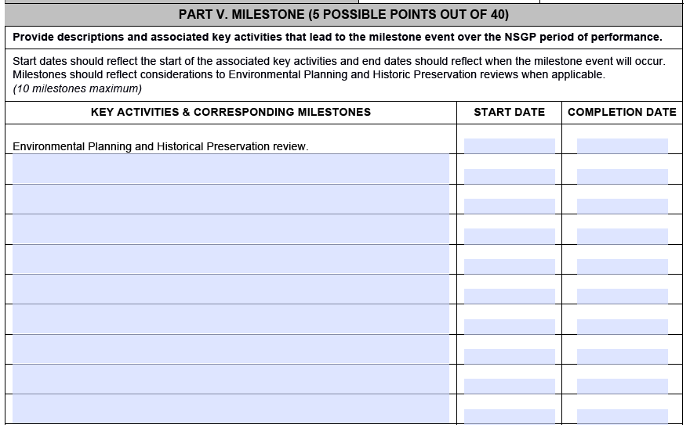
Application – IJ Milestones
  Best Practices
    Realistic Dates
    Address all aspects of project management
    Dates align with projected award dates.
    Be concise!
  Common Pitfalls
    Skipping dates for completion of EHP.
    Dates outside of the project performance period dates.

Slide 24
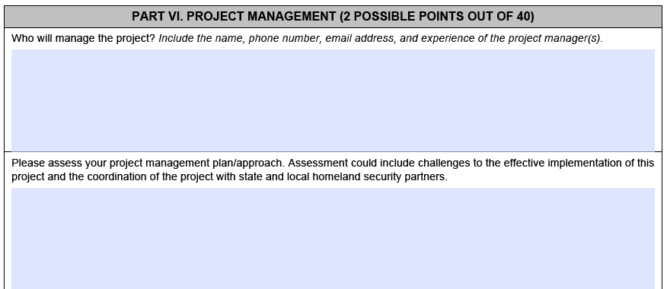
Application – IJ Project Management

Slide 25
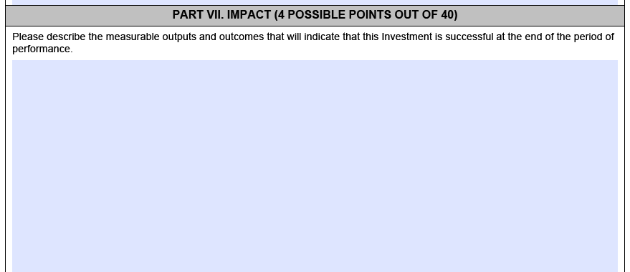
Application – IJ Impact
  Best Practices
    Cover all aspects/projects
    Be concise!
  Common Pitfalls
    Being vague or assuming reviewer knows
    Not answering

Slide 26
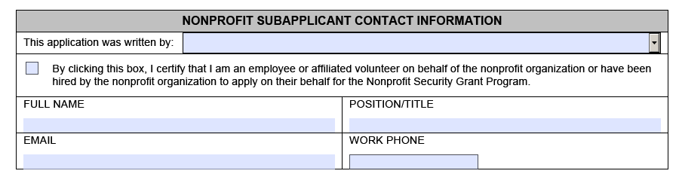
Application – IJ Contact and Other Considerations
Contact should be the person who has the authority for the non-profit and knowledge to answer any questions we may have.
Other considerations: Be realistic, costs are increasing regularly. Your non-profit may want to look at taking a phased approach. Apply for the most important/impactful first.

Slide 27
Application Review Deadline
May 16, 2024 at 11:59 pm
(This is only if you’d like us to review and provide feedback on your application)
Notes:
________________________________________________________________
________________________________________________________________
________________________________________________________________
________________________________________________________________
________________________________________________________________
________________________________________________________________

Slide 28
Key Requirements if Awarded
Environmental & Historic Preservation (EHP) Compliance
Quarterly Reporting
See 2024 State Overview and Guidelines for a full list of compliance requirements, available at: https://ready.alaska.gov/Grants/nsgp
Build American Buy America Act (BABAA)
Procurement Requirements and Documentation

Slide 29
Applications are due May 31st by 11:59 pm
ready.alaska.gov/grants
1-800-478-2337 or 907-428-7000
Email: mva.grants@alaska.gov
Notes:
________________________________________________________________
________________________________________________________________
________________________________________________________________
________________________________________________________________
________________________________________________________________
________________________________________________________________

