Slide 1
Alaska Partnership for Infrastructure Protection
Welcome!
Our session will begin shortly.
Please –
Mute your microphone, unless you are commenting to the group
Keep your camera off, unless you are addressing the group – it saves on bandwidth
On your phone?
*6 to mute
*7 to unmute
Shawna Watson – Alaska Communications
Bob Carmichael– State of Alaska, DHS&EM
16 March, 2023

Slide 2
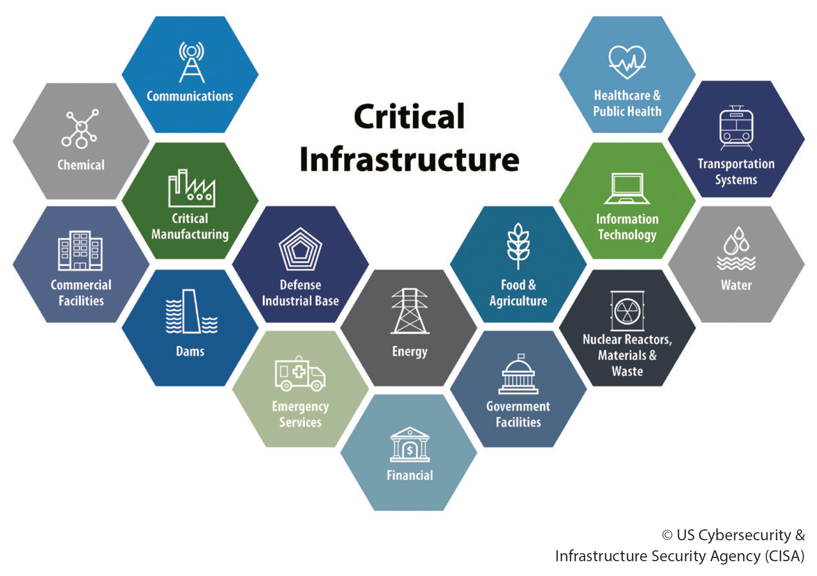
Alaska Partnership for Infrastructure Protection
Shawna Watson – Alaska Communications
Bob Carmichael– State of Alaska DHS&EM
16 March, 2023

Slide 3
Agenda
Introduction: Public and Private Sector Co-Chairs
Director’s Welcome –Bryan J. Fisher
Security at the Front Desk
Threat updates
Next month: Debris Management
Coming soon: Talk-back to APIP

Slide 4
Co-Chairs: APIP Private Sector APIP Public Sector
Shawna Watson
APIP Private Sector Co-Chair
Manager, Business Continuity, Emergency Management, and Safety
Alaska Communications
ACS HQ in Anchorage
907-565-6935 office
Shawna.Watson@acsalaska.com
Bob Carmichael
APIP Public Sector Co-Chair
Emergency Management Specialist II
Division of Homeland Security and Emergency Management
Office at JBER
907-428-7020 office
Bob.Carmichael@alaska.gov

Slide 5
Agenda
Introduction: Public and Private Sector Co-Chairs
Director’s Welcome – Bryan Fisher
Security at the Front Desk
Threat updates
Next month: Debris Management
Talk-back to APIP
Bryan Fisher is the Director of the Alaska Division of Homeland Security and Emergency Management.

Slide 6
Agenda
Introduction: Public and Private Sector Co-Chairs
Director’s Welcome – Bryan Fischer
Security at the Front Desk
Threat updates
Next month: Debris Management
Talk-back to APIP

Slide 7
Security at the Front Desk
James Estes
Beverly Boyd
First National Bank

Slide 8
Agenda
Introduction: Public and Private Sector Co-Chairs
Director’s Welcome – Bryan Fisher
Security at the Front Desk
Threat updates
Next month: Debris Management
Talk-Back to APIP

Slide 9
Threat Updates
COVID 19 and other viruses
The Flipper Zero
Removable Media
Cyber Disruptions
Travel – disruptive passengers

Slide 10
Agenda
Introduction: Public and Private Sector Co-Chairs
Director’s Welcome – Bryan Fisher
Security at the Front Desk
Threat updates
Next month:
April 20, 1000 to 1200, virtual, MS Teams
Topic: Debris Management
Talk-back to APIP

Slide 11
Questions? Comments? Announcements?

Slide 12
Meeting Adjourned
Shawna Watson, APIP Co-Chair (Private Sector), ACS
shawna.watson@acsalaska.com (907) 229-6300
Bob Carmichael, APIP Co-Chair (Public Sector), DHS&EM
bob.carmichael@alaska.gov (907) 428-7020
APIP Webpage: https://ready.alaska.gov/APIP
Next Meeting will be 20 April, 2023
1000 to 1200 Alaska time, virtual (MS Teams)

Slide 13
Agenda
Introduction: Public and Private Sector Co-Chairs
Director’s Welcome – Bryan Fisher
Security at the Front Desk
Threat updates
Next month:
April 20, 1000 to 1200, virtual, MS Teams
Topic: Debris Management
Talk-back to APIP

