Slide 1
Alaska Partnership for Infrastructure Protection
Welcome!
Our session will begin shortly.
Please –
Mute your microphone, unless you are commenting to the group
Keep your camera off, unless you are addressing the group – it saves on bandwidth
On your phone?
*6 to mute
*7 to unmute
Shawna Watson – Alaska Communications
Bob Carmichael– State of Alaska, DHS&EM
16 February, 2023

Slide 2
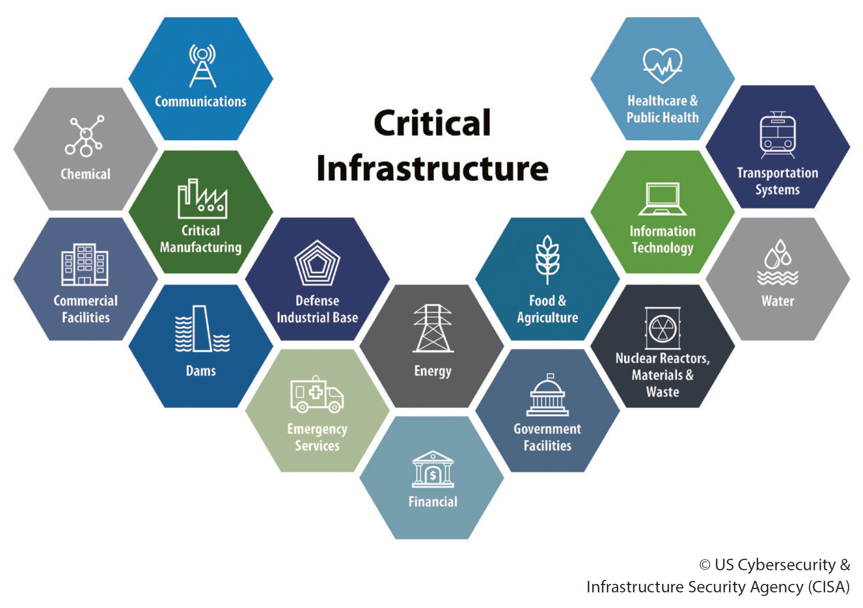
Alaska Partnership for Infrastructure Protection
Shawna Watson – Alaska Communications
Bob Carmichael– State of Alaska DHS&EM
16 February, 2023

Slide 3
Agenda
Introduction: Public and Private Sector Co-Chairs
Director’s Welcome –Bryan J. Fisher
Food, Water, and Emergency Supplies
Threat updates
Next month: Security at the Front Desk

Slide 4
Co-Chairs: APIP Public Sector APIP Private Sector
Introduction to Shawna Watson
APIP Private Sector Co-Chair
Manager, Business Continuity, Emergency Management, and Safety
Alaska Communications
Office in Anchorage
907-565-6935 office
Shawna.Watson@acsalaska.com
Introduction to Bob Carmichael
APIP Public Sector Co-Chair
Emergency Management Specialist II
Division of Homeland Security and Emergency Management
Office at JBER
907-428-7020 office
Bob.Carmichael@Alaska.gov

Slide 5
Agenda
Introduction: Public and Private Sector Co-Chairs
Director’s Welcome – Bryan Fisher
Food, Water and Emergency Supplies
Threat updates
Next month: Security at the Front Desk
Bryan Fisher is the Director of the Alaska Division of Homeland Security and Emergency Management.

Slide 6
Agenda
Introduction: Public and Private Sector Co-Chairs
Director’s Welcome – Bryan Fischer
Food, Water and Emergency Supplies
Threat updates
Next month: Security at the Front Desk

Slide 7
Food, Water and Emergency Supplies
Bob Carmichael MA, CSP, CHMM, CHST, OHST

Slide 8
Food, Water, and Emergency Supplies
Bob Carmichael

Slide 9
The BIG picture
As you know:
Disasters happen
You need to have safe water
You need to have safe food
You need shelter and clothing
You might need medical supplies
It’s not just you – Home, Work, Others, Pets

Slide 10
Get to know your disaster
You may never know when, but you can get a good idea as to what.
Flood
Volcano
Earthquake
Fire
Tsunami
Civil Disturbance
Power Outage
Wind
Hazardous Materials
Supply Chain

Slide 11
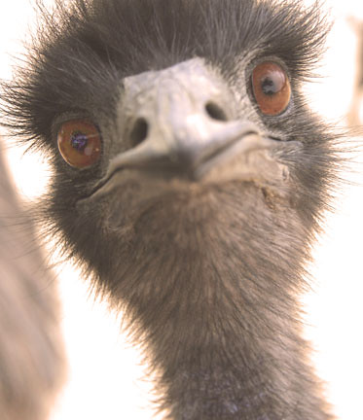
Time is not your friend
Time to prepare
Time to protect
Time to renew
Time to use
At least 3 days

Slide 12
food
You don’t need to buy dehydrated or special emergency foods
Look for items with a long storage life
Select items that require little or no cooking, water, or refrigeration
Try to avoid salty or spicy items
Plan for babies, those with special dietary needs, and pets
Check expiration dates
Ideal storage location is cool, dry, and dark
Avoid exposure to heat from the sun, stoves, and refrigerators
Store away from petroleum products. Some foods absorb their smell.
Protect supplies from rodents and insects

Slide 13
Water
Water
Drip
Drip
Drip
Drip
Drip
Drip
Drip
One gallon per day per person / pet
At least 3 days worth – 2 weeks is better
Have unscented chlorine bleach available, replace every year, keep cool, 1 to 10
Replace water every 6 months
Use food-grade storage containers
Containers should be air tight, can’t break, never used for toxics, milk, fruit juices
Store out of direct sunlight

Slide 14
Emergency Supplies
Make fire!
Cooking utensils
Knives, forks, spoons
Paper plates, paper cups, paper towels
Manual can opener
Heavy-duty aluminum foil
Propane or charcoal grill, camp stove
Fuel
First aid / medications / supplies
Tools, axe
Radio, batteries, phone
Marshmallows
?
?
?
?
?

Slide 15
Agenda
Introduction: Public and Private Sector Co-Chairs
Director’s Welcome – Bryan Fisher
Food, Water and Emergency Supplies
Threat updates
Next month: Security at the Front Desk

Slide 16
Threat Updates
COVID 19 and other viruses
Food Chain – eggs, paper products, etc
Cyber Disruptions – Lots of people trying
Travel Disruptions – vendors, software

Slide 17
Agenda
Introduction: Public and Private Sector Co-Chairs
Director’s Welcome – Bryan Fisher
Food, Water and Emergency Supplies
Threat updates
Next month:
March 16, 1000 to 1200, virtual, MS Teams
Topic: Security at the Front Desk

Slide 18
Questions? Comments? Announcements?

Slide 19
Meeting Adjourned
Bob Carmichael, APIP Co-Chair (Public), DHS&EM
bob.carmichael@alaska.gov (907) 428-7020
Shawna Watson, APIP Co-Chair (Private), ACS
shawna.watson@acsalaska.com (907) 229-6300
APIP Webpage: https://ready.alaska.gov/APIP
Next Meeting will be 16 March, 2023
1000 to 1200 Alaska time, virtual (MS Teams)

